Slide 1

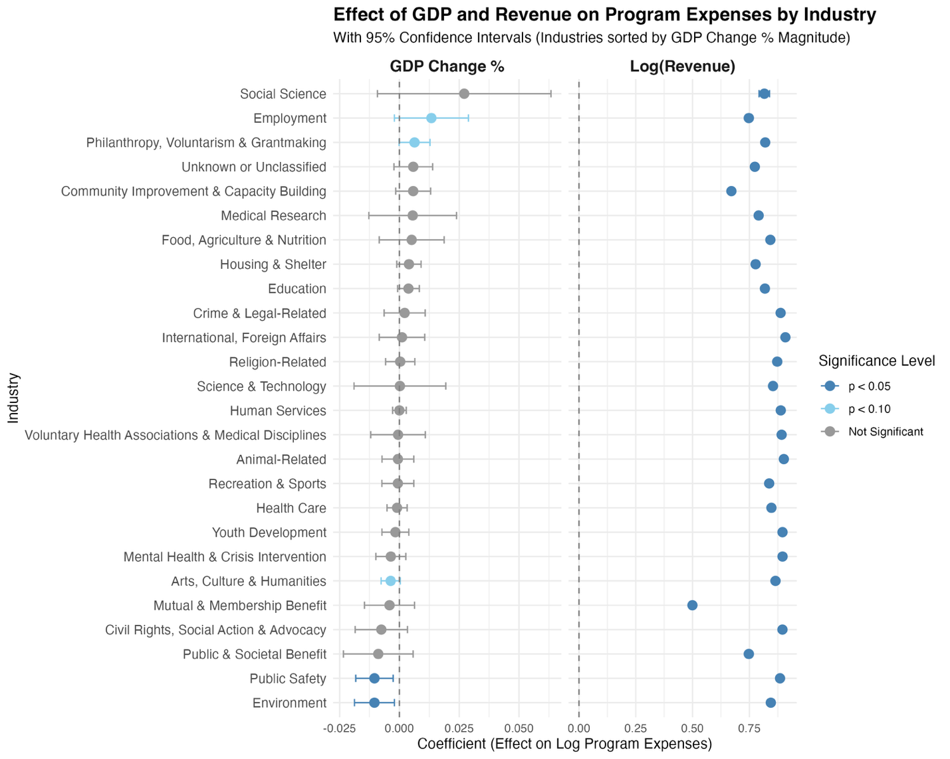
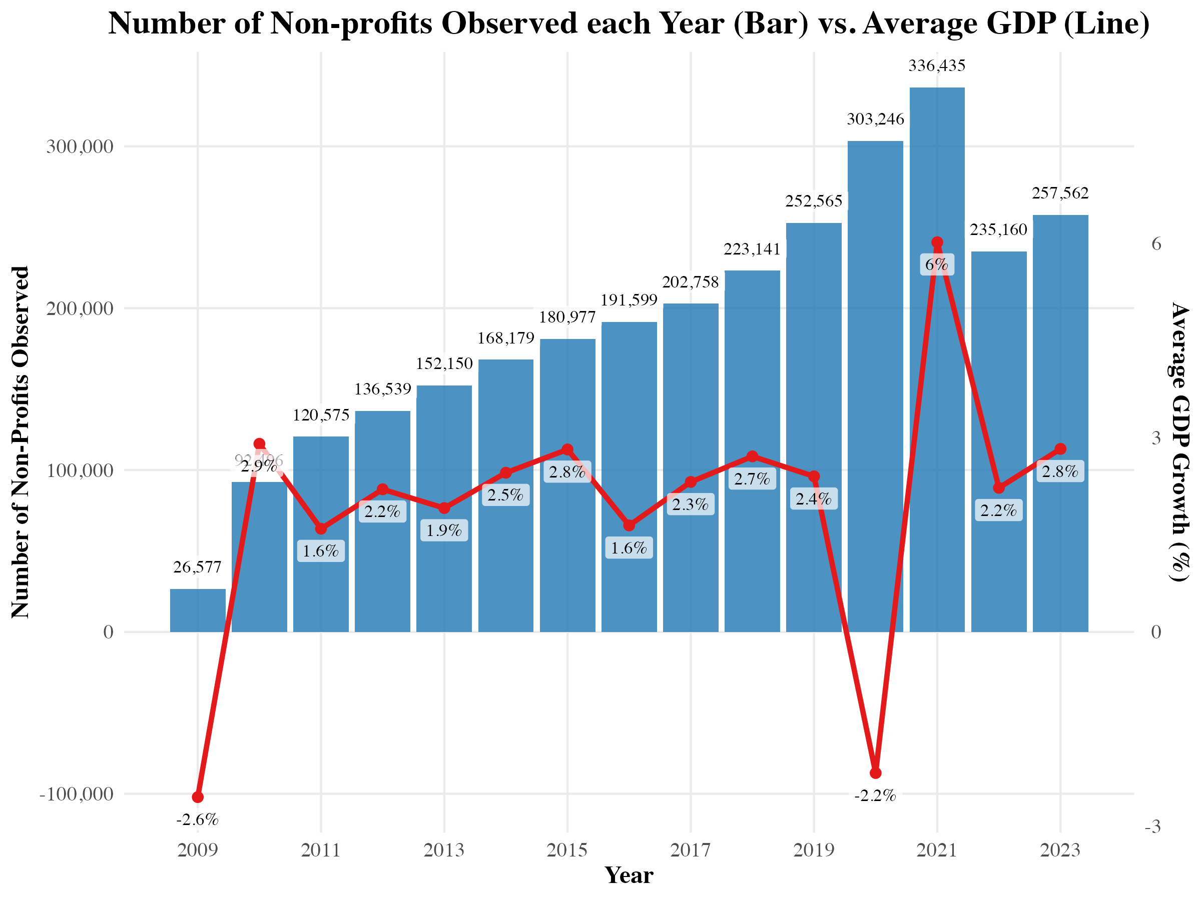
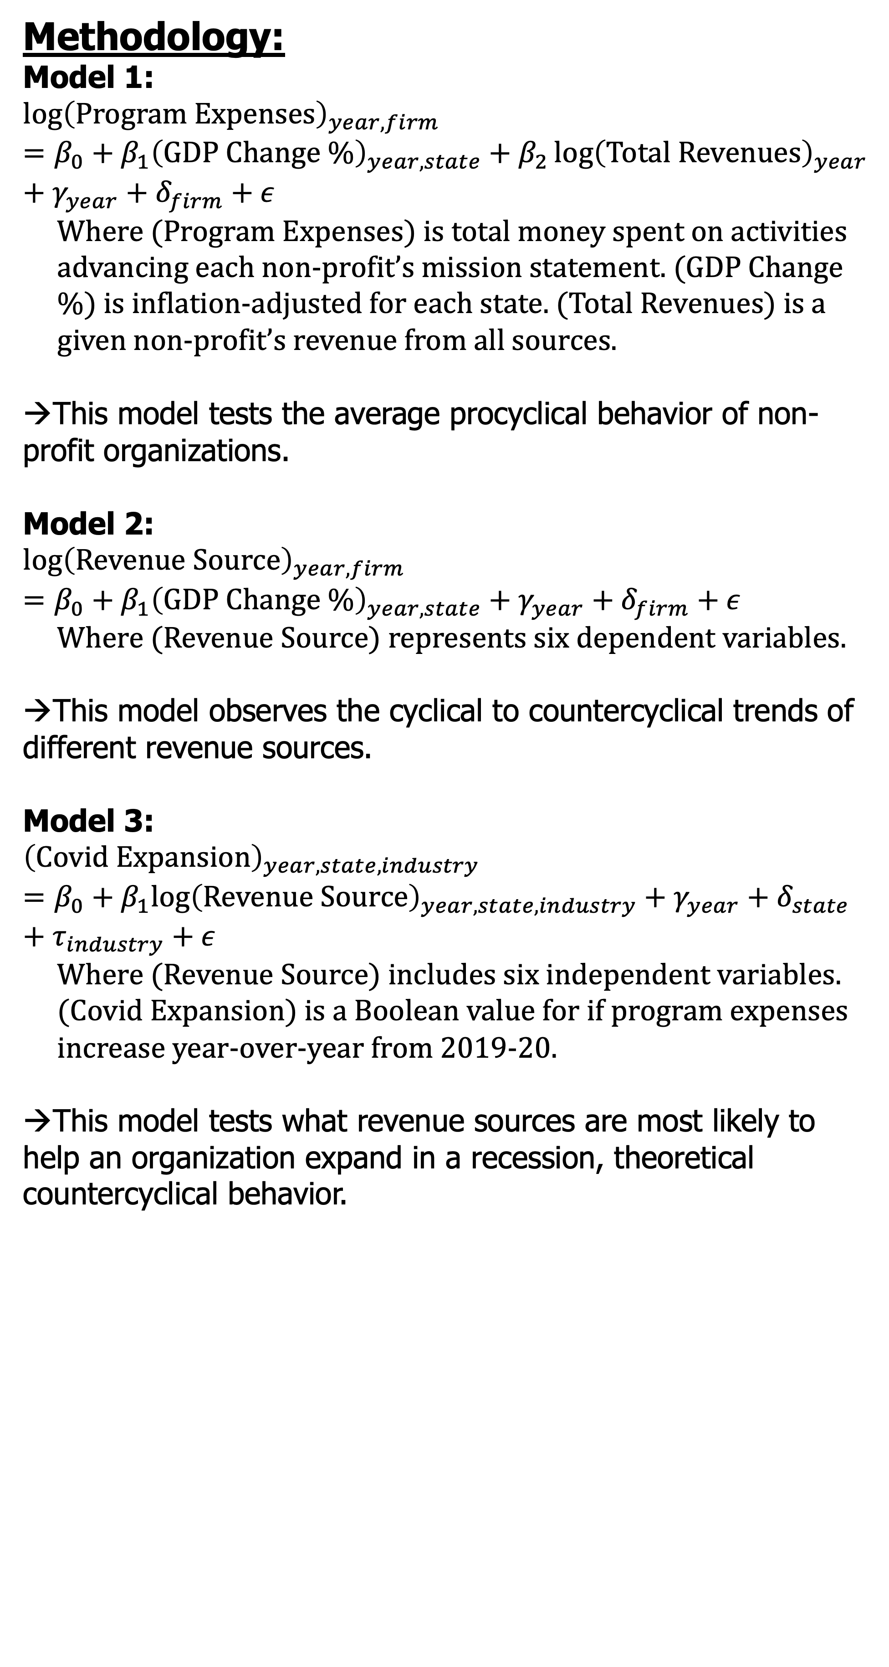
Running a Non-Profit in a Recession: Analysis of Countercyclical Financial Practices
Jonathan Tamen ‘26 – (Sponsor: Professor Magda Tsaneva)
Research Question: What revenue sources are most correlated with helping non-profits do more when the economy is doing worse?
Methodology:
Model 1:
$${\log\left(Program Expenses\right)}_{year,firm}=β_{0}+β_{1}{\left(GDP Change \%\right)}_{year,state}+β_{2}{\log\left(Total Revenues\right)}_{year}+γ_{year}+δ_{firm}+ε$$
Where (Program Expenses) is total money spent on activities advancing each non-profit’s mission statement. (GDP Change %) is inflation-adjusted for each state. (Total Revenues) is a given non-profit’s revenue from all sources.
→This model tests the average procyclical behavior of non-profit organizations.
Model 2:
$${\log\left(Revenue Source\right)}_{year,firm}=β_{0}+β_{1}{\left(GDP Change \%\right)}_{year,state}+γ_{year}+δ_{firm}+ε$$
Where (Revenue Source) represents six dependent variables.
→This model observes the cyclical to countercyclical trends of different revenue sources.
Model 3:
$${\left(Covid Expansion\right)}_{year,state,industry}=β_{0}+β_{1}log{\left(Revenue Source\right)}_{year,state,industry}+γ_{year}+δ_{state}+τ_{industry}+ε$$
Where (Revenue Source) includes six independent variables. (Covid Expansion) is a Boolean value for if program expenses increase year-over-year from 2019-20.
→This model tests what revenue sources are most likely to help an organization expand in a recession, theoretical countercyclical behavior.
Results:
Model 3 Results: | Covid Expansion | Pre-Covid Robustness Check
Log(Donations) | 0.003*** | 0.004***
 | (0.000) | (0.000)
Log(Fundraising) | 0.002*** | 0.005***
 | (0.000) | (0.000)
Log(Govt Grants) | 0.011*** | 0.008***
 | (0.000) | (0.000)
Log(Membership) | -0.006*** | -0.003***
 | (0.000) | (0.000)
Log(Investment) | -0.005*** | -0.003***
 | (0.000) | (0.000)
Log(Other) | 0.000** | -0.000***
 | (0.000) | (0.000)
Num. Obs. | 2.32M | 2.17M
R2 | 0.079 | 0.058
R2 Adj. | 0.079 | 0.058
FE: year | X | X
FE: state | X | X
FE: industry | X | X
* p < 0.1, ** p < 0.05, *** p < 0.01
Background and Motivation:
Non-profit organizations suffer from an overall cyclical ‘dilemma’ during an economic recession:
The demand for philanthropic services increases. For example, more people will request support for food services or job training. (Bridgeland et al., 2010)
The supply of certain non-profit revenues decreases. For example, people/corporations will have less disposable incomes and fundraising will be less effective. (Exley, Lehr, and Terry, 2023)
Thus, non-profit organizations should operate ‘countercyclically’ to expand their programs when demand increases and smooth revenues from good times for bad times. (Jones et al., 2012)
In certain contexts, this countercyclicality occurs. (Pollifroni, Militaru, and Socaciu, 2014)
However, research is limited so less information exists for non-profit leaders to define ‘resilient financial practices’ for the entire non-profit enterprise in the United States to follow.
On average, for a 1 percentage point increase in real GDP Change (i.e., from 2% to 3% growth), a non-profit’s total revenue and program expenses increase by 0.6%.
Model 2 Results: | (1) Donations | (2) Fundraising | (3) Govt. Grants | (4) Membership | (5) Investments | (6) Miscellaneous
GDP Change % | -0.000 | 0.004*** | -0.001 | 0.002*** | 0.000 | -0.003**
 | (0.001) | (0.001) | (0.001) | (0.001) | (0.001) | (0.001)
Num. Obs. | 2.88M | 2.88M | 2.88M | 2.88M | 2.88M | 2.88M
R2 | 0.754 | 0.705 | 0.780 | 0.859 | 0.877 | 0.712
FE: year | X | X | X | X | X | X
FE: state | X | X | X | X | X | X
FE: industry | X | X | X | X | X | X
FE: firm | X | X | X | X | X | X
* p < 0.1, ** p < 0.05, *** p < 0.01
Effect = β%
E.g., ”a 1% increase in Investment Revenues is correlated with a 0.005%-point decrease in expansion probability”
Data:
2.88 million observations
319,000 non-profit organizations across 25 industries
15 years and all 50 US states
Effect = β * 100%
E.g., ”a 1% Change in Real GDP is correlated with a 0.3% decrease in Miscellaneous Revenues”
Model 1 Results: | (1) Expenses | (2) Revenues | (3) Revenue-Controlled
GDP Change % | 0.006*** | 0.006*** | 0.001
 | (0.001) | (0.001) | (0.001)
Log(Revenue) |  |  | 0.823***
 |  |  | (0.001)
Num. Obs. | 2.88M | 2.88M | 2.88M
R2 | 0.847 | 0.844 | 0.921
FE: year | X | X | X
FE: state | X | X | X
FE: industry | X | X | X
FE: firm | X | X | X
* p < 0.1, ** p < 0.05, *** p < 0.01
Conclusion:
Key Findings
The non-profit sector is largely procyclical.
Total revenue explains the majority of variance in program changes.
Revenue streams dependent on individual discretionary decisions are more procyclical.
Government grants and cash from donations and fundraising provided the strongest positive correlation for expanding programs during the Covid-19 recession. But the effect is very small.
Maintaining highly liquid, unrestricted revenue streams or pre-existing pipelines for government grants increases an organization’s probability to expand when society needs them most.
Future Research
Should define specific financial practices either from interviews to gauge recommended practices or by testing techniques from literature.
Should dissect mechanics further by examining detailed changes in balance sheets, such as the specific reallocation of assets and liabilities during a shock.
Should pair quantitative panel data with qualitative interviews of directors to determine if countercyclical planning is an active concern.
Effect = β%
E.g., ”a 1% increase in Revenue is correlated with a 0.8% increase in Program Expenses”

